Slide 1
Boundless CTA panel
Testing new panel option

Slide 2
What can we accomplish?
The boundless microsite is essential to the university’s brand.
Acknowledging brand goals can conflict with business goals, we can respond to both—broadening our audience and highlighting the high-quality storytelling represented through boundless stories.
Provide greater flexibility to boundless writers, editors, and publishers.
Bridge student paths to enrollment.
Ensure the longevity of the microsite—whether as “aspirations,” “boundless,” or something new.

Slide 3
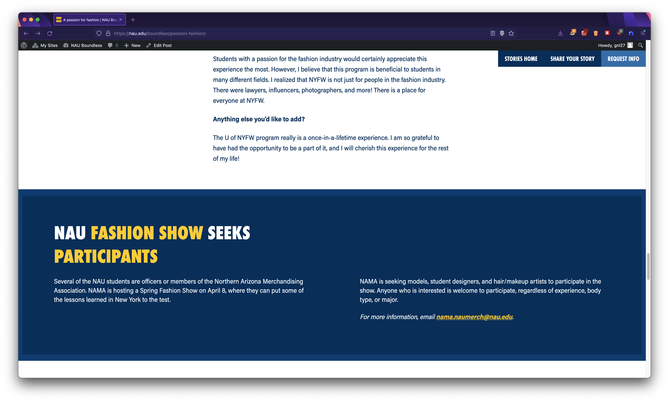
What about our current panels?
Limited panel blocks
The exiting “NAU block” does not provide much flexibility to accommodate our content or user experience needs:
Valuable to add content at the bottom
Appears to be a footer and signals end of content when there could be more
Challenging to reposition on the page
Can be blue or grey
Some content needs more flexibility

Slide 4
What’s our path forward?
Next steps
After consulting with HT and RY, we’ve been asked as a team to test a CTA feature.

Slide 5
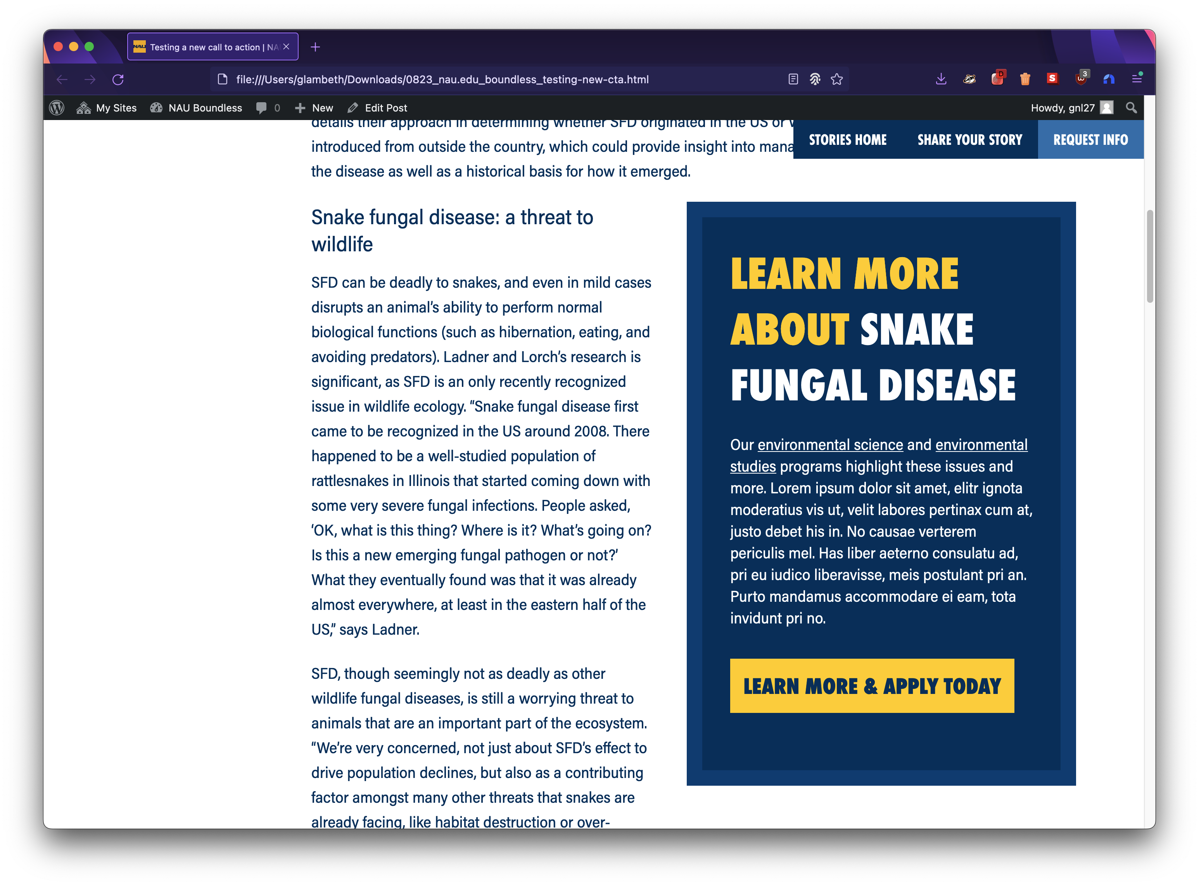
What’s our path forward?
Next steps
After consulting with HT and RY, we’ve been asked as a team to test a CTA feature:
Develop a prototype.
Update content following HT’s guidance
Screenshot of a prototype that I built.

Slide 6
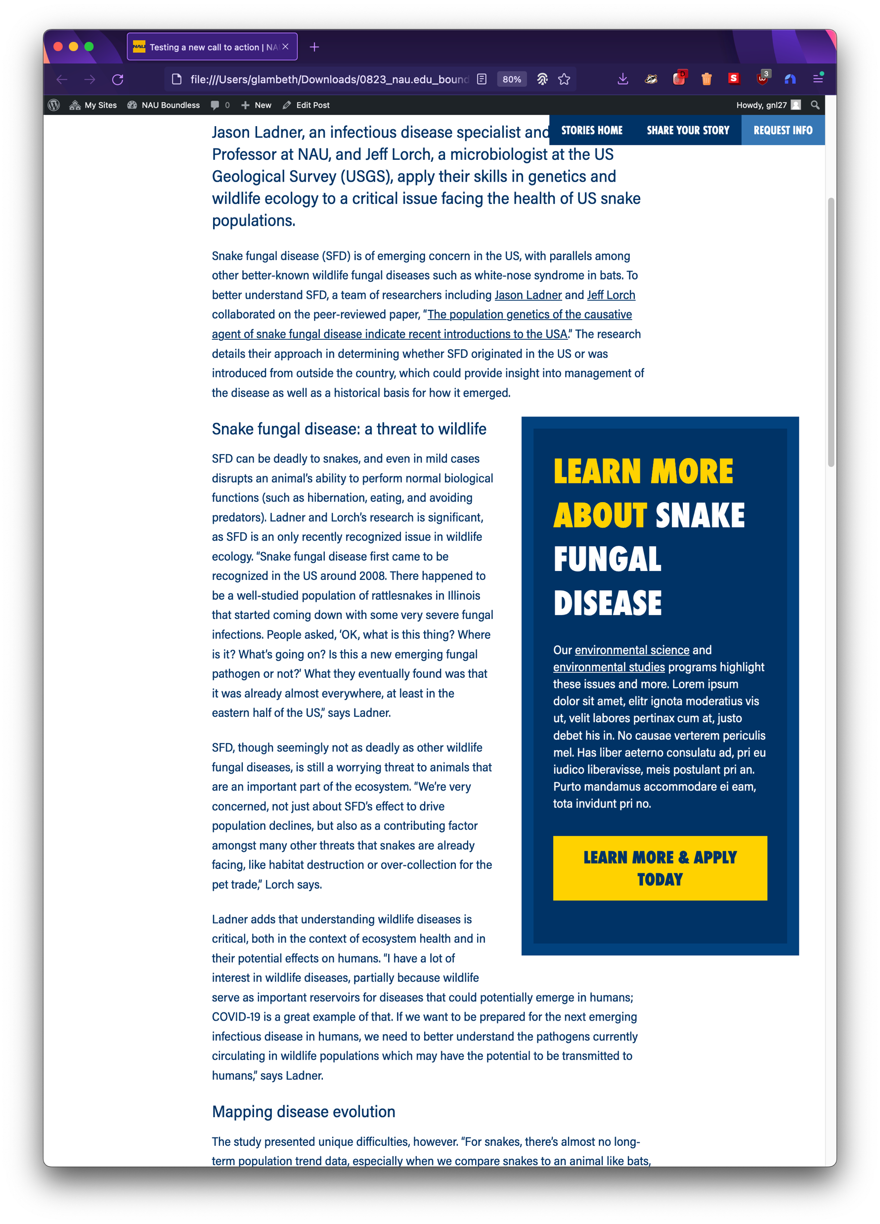
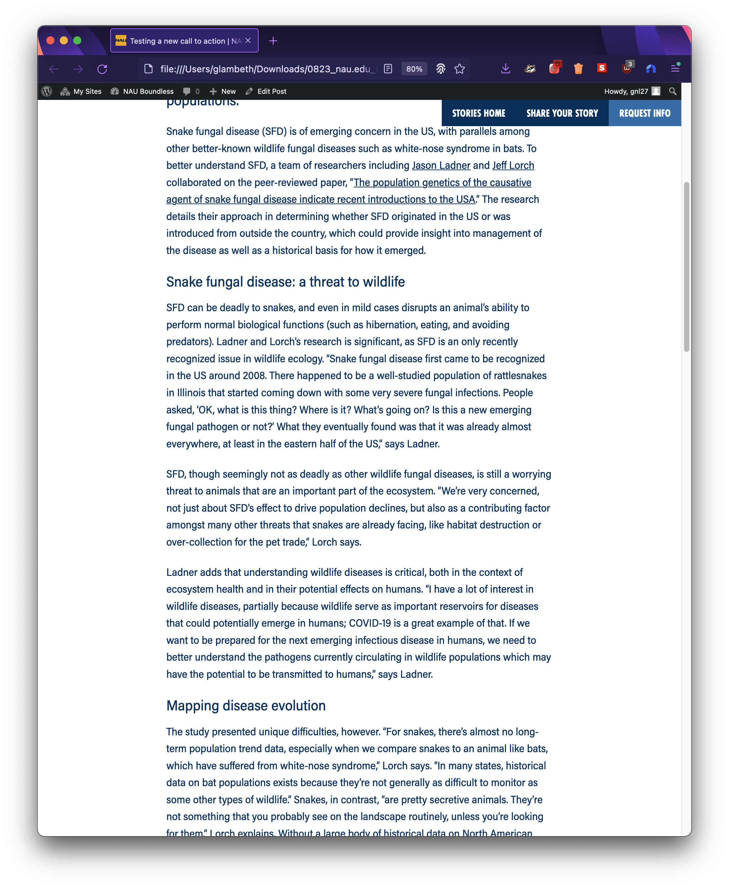
What’s our path forward?
Next steps
After consulting with HT and RY, we’ve been asked as a team to test a CTA feature:
Develop a prototype.
Use AB testing to compare user responses to different experiences:
published once
approve test feature preview
socialize via social and working group
feature is hidden or shown selectively
feature hidden end of test (1-3 months)
50% of users see each option for a limited time (two weeks).

Slide 7
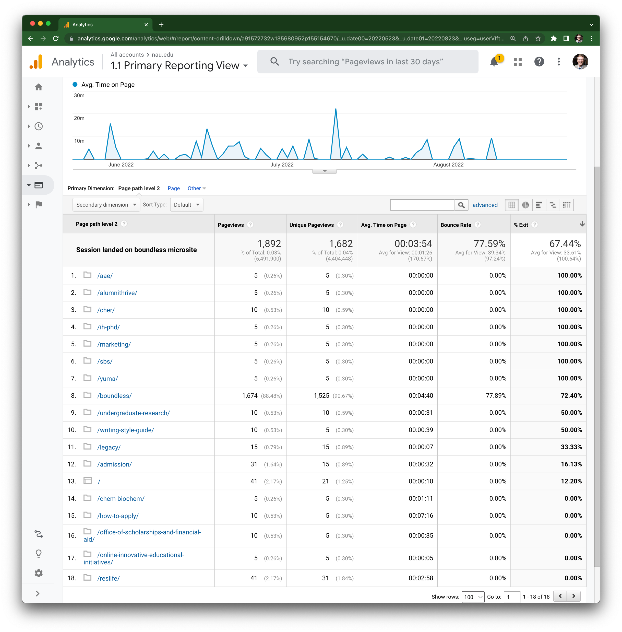
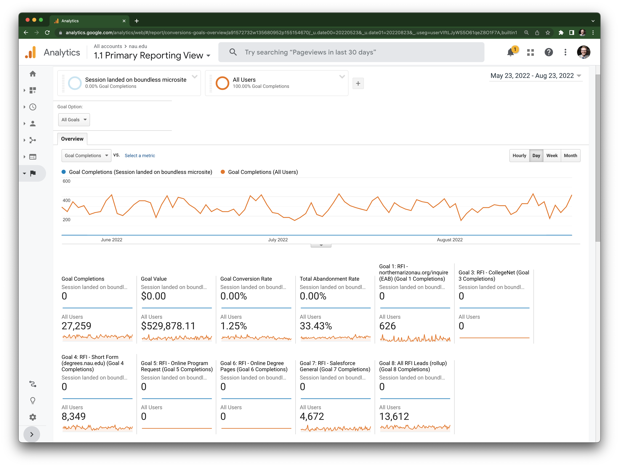
What’s our path forward?
Next steps
After consulting with HT and RY, we’ve been asked as a team to test a CTA feature:
Develop a prototype.
Use AB testing to compare user responses to different experiences.
Review and determine path based on data.
Analyze how panels perform against goals and conversions.

Slide 8
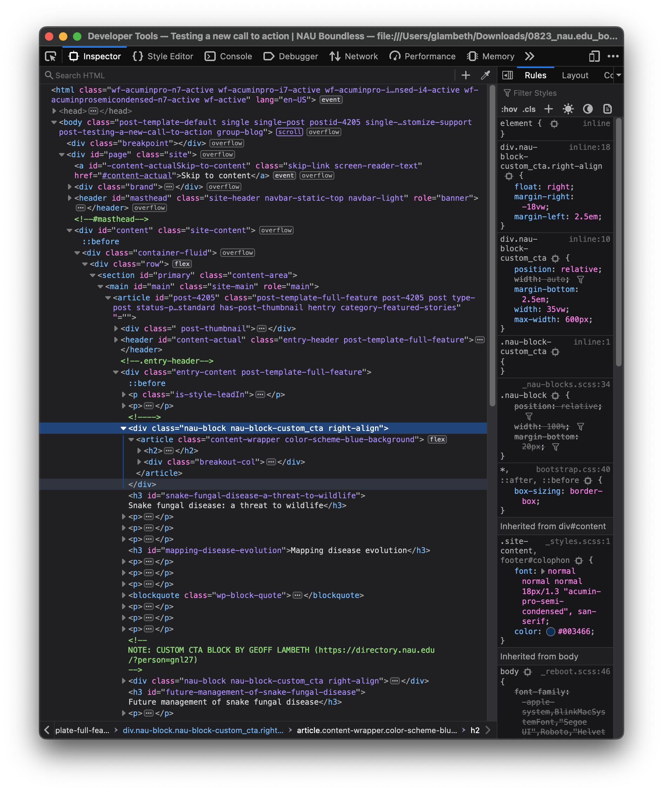
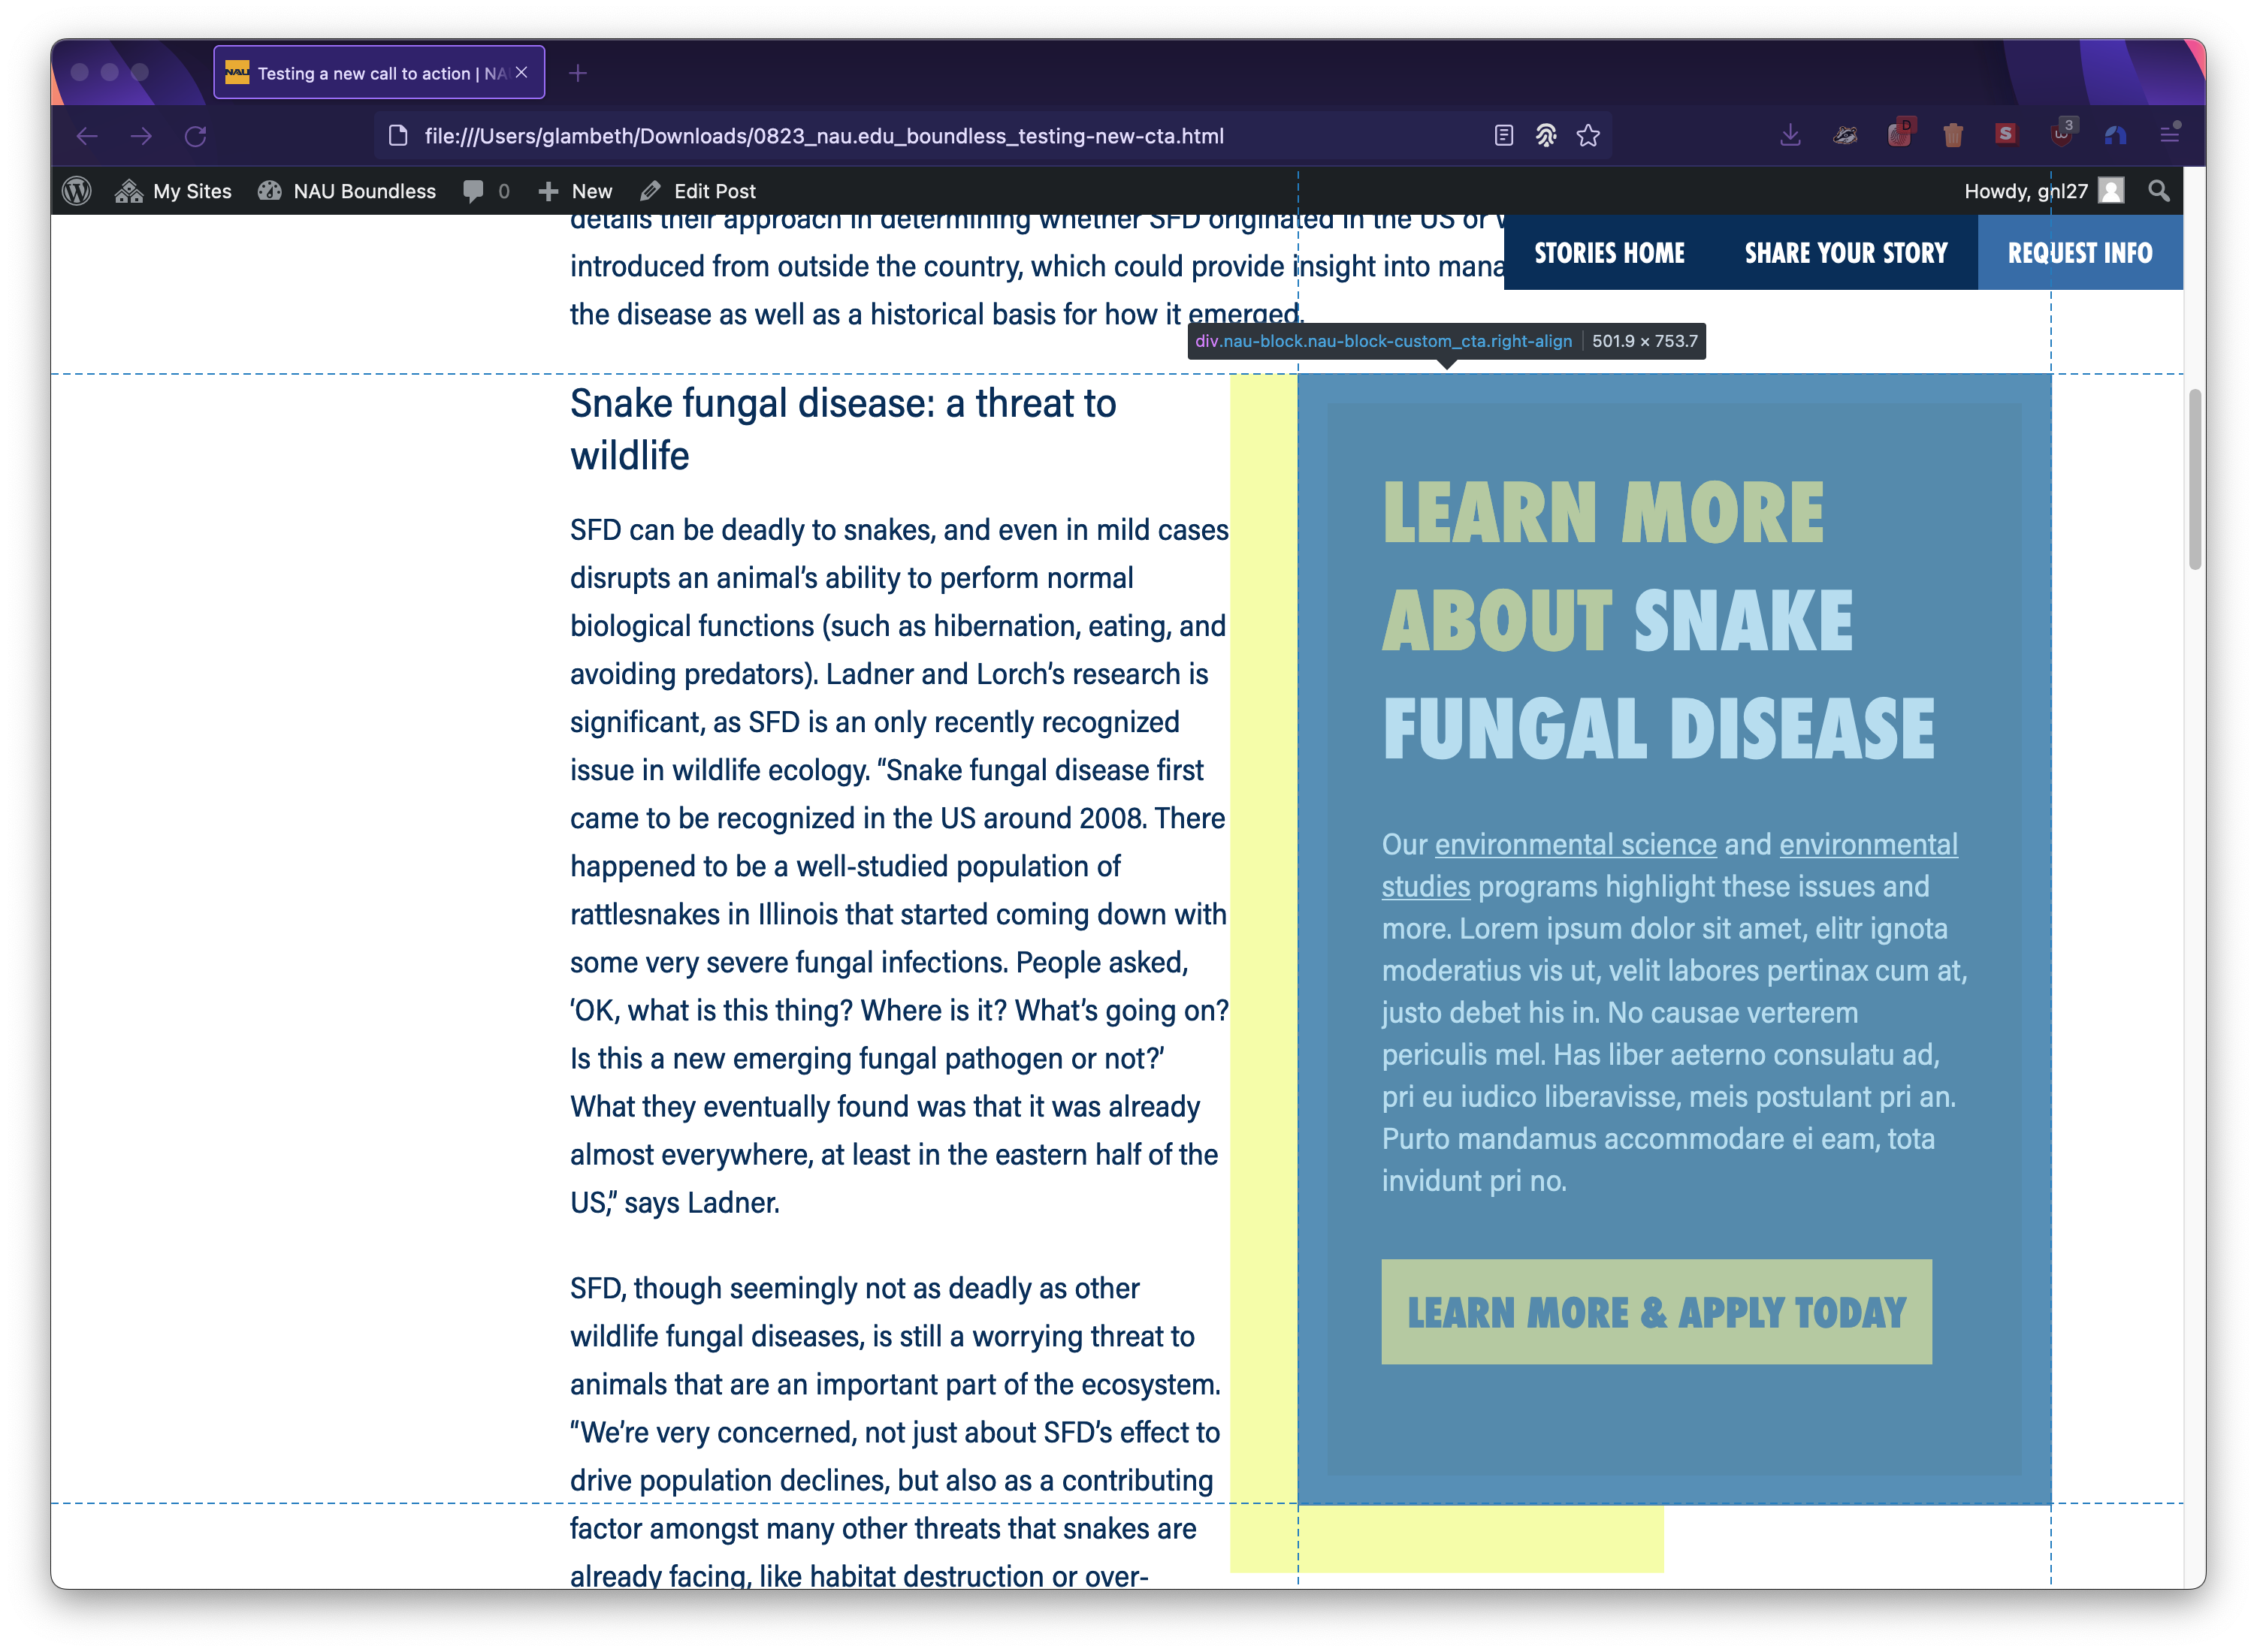
What’s our path forward?
Next steps
After consulting with HT and RY, we’ve been asked as a team to test a CTA feature:
Develop a prototype.
Use AB testing to compare user responses to different experiences.
Review and determine path based on data.
Pass to ITS for development based on our test of optional panels.

Slide 9
What’s our path forward?
Next steps
After consulting with HT and RY, we’ve been asked as a team to test a CTA feature:
Develop a prototype.
Use AB testing to compare user responses to different experiences.
Review and determine path based on data.
Pass to ITS for development based on our test of optional panels.

Slide 10
Preview current prototype

Slide 11
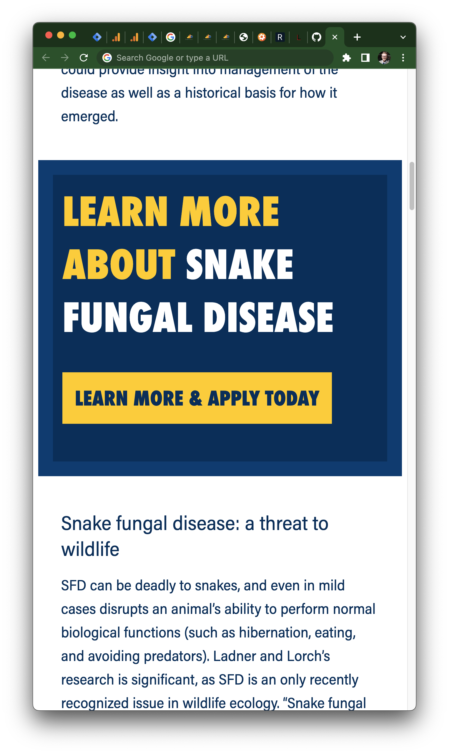
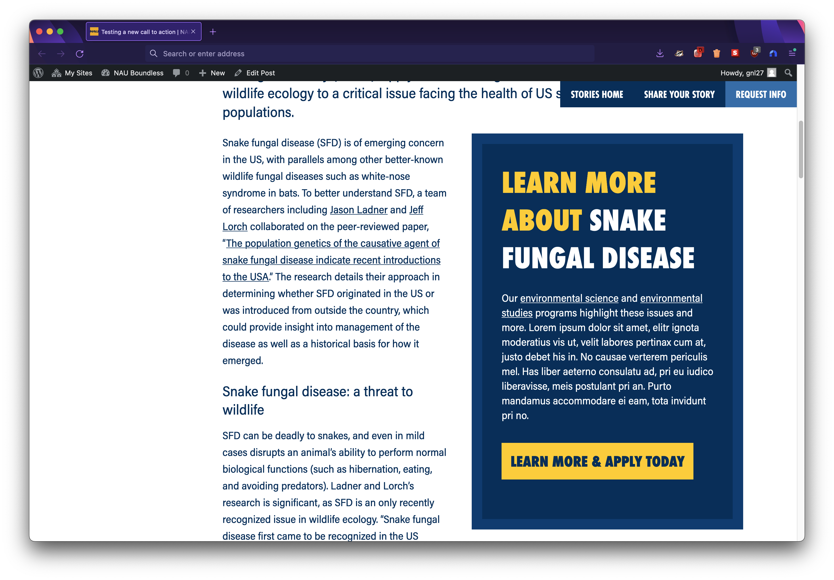
Call to action prototype
Hypothesis: a call-to-action panel in the upper-right of the page will lower exit rates and increase conversions across the boundless microsite rather than on individual stories.
Similar to online shopping “buy now” panels
Should feel familiar to users
Uses same styling as “NAU block”
Mobile and desktop prototypes.

Slide 12
Future prototypes
Once we’ve been through this process and evaluated our success or failure, we may be able to begin other panel discussions to fill gaps on the site.

Slide 13
Questions?

Slide 14
Thank you

